Slide 1


Department of BES-I
COURSE: Data Structures using Python
COURSE CODE: 24SC1204
Topic:
Name of the topic: Linear probing, Quadratic probing, Separate chaining
Session – 21

Slide 2



AIM OF THE SESSION
To familiarize students with the basic concept of Collision Resolution Techniques
INSTRUCTIONAL OBJECTIVES
This Session is designed to:
Demonstrate Collision resolution techniques
Describe the types of collision resolution techniques
Describe each method
.
LEARNING OUTCOMES
At the end of this session, you should be able to:
Define Collision resolution techniques
Describe types of collision resolution techniques.
Summarize definition, types of resolution techniques and its applications

Slide 3
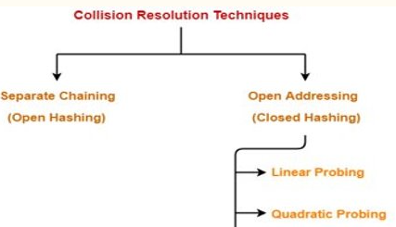
Introduction To Collision Resolution Techniques
Collision occurs when multiple keys are mapped to the same index (slot) in a hash table by the hash function.
For example, several students having the same locker number in a school, leading to potential conflicts for storage and retrieval.
The collision creates a problem because each index in a hash table is supposed to store only one value.
There are several collision resolution techniques to manage the performance of a hash table. The two most popular techniques are:
1. Open Hashing
      Separate Chaining
2. Closed Hashing or Open Addressing
      Linear Probing
      Quadratic Probing

Slide 4
Introduction To Collision Resolution Techniques
Open Hashing
Each Bucket in the Hash table is the head of a Linked List.
All Elements that hash to a Particular Bucket are Placed on the Buckets Linked List .
Closed Hashing
Ensures that all elements are stored directly into the Hash Table.

Slide 5
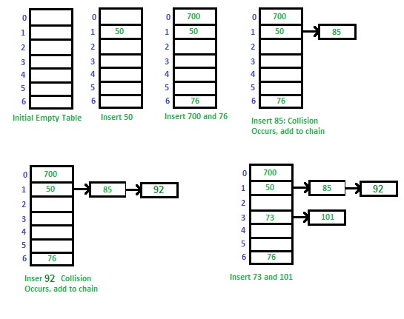
Separate Chaining
It is a collision resolution technique that handles collisions in hash tables by storing colliding keys in linked lists.
Instead of having a single value at each slot, each slot holds a linked list (or chain) of keys that have hashed to the same index.
The hash function for the Separate Chaining is:
h(key) = key% table_size.
Example: Consider a sequence of keys as 50, 700, 76, 85, 92, 73, 101 with table_size 7.
h(key) = key% table_size.
h(50) = 50%7 = 1 h(92) = 92%7 = 1
h(700) = 700%7 = 0 h(73) = 73%7 = 3
h(76) = 76%7 = 6 h(101) = 101%7 = 3
h(85) = 85%7 = 1

Slide 6
Linear Probing
It's an open addressing collision resolution technique.
When a collision occurs, it probes sequentially for the next available slot in the hash table.
The hash function for the Linear Probing to an initial index:
h(key) = Key% Table_size.
If a collision occurs at the any index, linearly probe for the next available slot:
probe_index(key) = (key + i) % Table_size
Where, i is the probe count, starting from 1 and incrementing for each failed attempt.
Working Mechanism
Calculate the hash value: Use a hash function to determine the initial slot for a key.
Check for collision: If the slot is occupied, start linear probing:
    Sequentially check the next available slot in the table.
    Wrap around to the beginning if you reach the end.
Insert or search: Once an empty slot is found, insert the key or search for it.

Slide 7
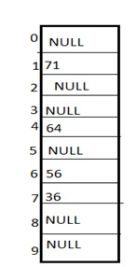
Linear Probing
Example: Consider a sequence of keys as 71, 64, 56, 36 with table size 10
The hash function for the Division method is:
h(key) = Key% table size.
h(71)=71%10=1
h(64)=64%10=4
h(56)=56%10=6
h(36)=36%10=6
Now, collision occurs at the index 6
probe_index(key) = (key + i) % Table_size
Initially i=1
probe_index(36) =(36+1)%10=7
Now, key 36 is placed at index 7

Slide 8
Quadratic Probing
It's a collision resolution technique used in hash tables that employ open addressing.
When a collision occurs (two keys hash to the same index), quadratic probing probes a sequence of alternate hash table indices using a quadratic function.
The hash function for the Quadratic Probing to an initial index:
h(key) = Key% Table_size.
If a collision occurs at the any index, linearly probe for the next available slot:
Quaprobe_index(key) = (key + i*i) % Table_size
Where, i is the probe count, starting from 1 and incrementing for each failed attempt.

Slide 9
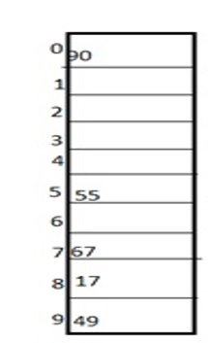
Quadratic Probing
Example: Consider a sequence of keys as 67, 90,55,49,17 with table size 10
​The hash function for the Division method is:
h(key) = Key% table size.
h(67) = 67%10 = 7
h(90) = 90%10 = 0
h(55) = 55%10 = 5
h(49) = 49%10 = 9
h(17) = 17%10 = 7
Now, collision occurs at the index 7
Quaprobe_index(key) = (key + i*i) % Table_size
Initially i=1
probe_index(17) =(17+1*1)%10=8
Now, key 17 is placed at index 8

Slide 10
IMPORTANT FACTS RELATED TO THE SESSION
Advantages of a Collision Resolution Techniques
Enable efficient hash table operations (insertion, deletion, search) in average cases, often achieving O(1) time complexity.
Allow for flexible hash table usage, even when collisions occur.
Disadvantages
Can degrade performance if the hash table becomes too full, potentially leading to worst-case O(n) time complexity.
Require careful selection of a good hash function to minimize collisions and ensure even key distribution.
Applications
Symbol tables
Caching

Slide 11
EXAMPLES
Let us consider a simple hash function as “key mod 5” and a sequence of keys that are to be inserted are 50, 70, 76, 93. Draw hash table using Linear probing technique.
Let us consider table Size = 7, hash function as Hash(x) = x % 7 and collision resolution strategy to be f(i) = i2 . Insert = 22, 30, and 50.

Slide 12
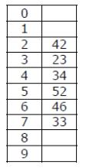
SELF-ASSESSMENT QUESTIONS
1.A hash table of length 10 uses open addressing with hash function h(k)=k mod 10, and linear probing. After inserting 6 values into an empty hash table, the table is as shown below.
Which one of the following choices gives a possible order in which the key values could have been inserted in the table?
(A) 46, 42, 34, 52, 23, 33
(B) 34, 42, 23, 52, 33, 46
(C) 46, 34, 42, 23, 52, 33
(D) 42, 46, 33, 23, 34, 52
2
2. Which of the following schemes does quadratic probing come under?
a) rehashing
b) extended hashing
c) separate chaining
d) open addressing

Slide 13
SUMMARY
Collision resolution techniques are crucial in hash tables to effectively deal with collisions occurring when different keys map to the same index.
Each technique has its own advantages and disadvantages, making the choice depend on specific needs and priorities.

Slide 14
TERMINAL QUESTIONS
List out different types of Collision Resolution Techniques?
The keys 12,18,13,2,3,23,5 and 15 are inserted into an initially empty hash table of length 10 using open addressing with hash function h(k)=k mod 10 and linear probing show the resultant hash table?
Define collision

Slide 15
REFERENCES FOR FURTHER LEARNING OF THE SESSION
Reference Books
Data Structures and Algorithm Analysis in PYTHON, 2010, Mark Allen Weiss, Second Edition, Pearson Education.
Data Structures and Algorithms, A.V.Aho, J.E.Hopcroft, and J.D.Ullman, Pearson Education, First Edition Reprint2003.
Advanced Guide to Python 3 Programming, John Hunt, 4th Edition, Springer Nature Switzerland AG 2019.
Python Basics: A Practice Introduction to Python 3, David Amos, Dan Bader, Joanna Jablonski, Fletcher Heisler, 4th edition, Real Python
.Sites and Web links:
https://docs.python.org/3/tutorial/datastructures.html
https://www.w3schools.com/dsa/dsa_intro.php
3. https://www.geeksforgeeks.org/python-data-structures/

Slide 16
THANK YOU
Team – Data Structures using Python

